Slide 1


Air Force Personnel Center
Air Force Day
Council of College and Military Educators 2017
Career Skills Program (CSP)
Ramona Kausch AFPC/DP2SST
6 March 2017 Air Force Day - CCME

Slide 2
OVERVIEW
CSP Roll-Out Accomplishments
CSP Process Review
Department of Defense Instruction (DoDI) Criteria for Vetting a Company
Questions and Answers
Backup Slides

Slide 3
CSP Accomplishments
Since publication of AFGM2 in August 2016
  Conducted Several MAJCOM / BamTech DCS Training Sessions
  Dissemination of MyPers Messages
  Dissemination of A1 Messages
  Conducted MAJCOM Conference Calls
  Solicited and Responded to Inquiries
  Conducted Legal Reviews
  Posted Updates to AFAEMS Resources

Slide 4

CSP Process
FOR TRANSITIONING SERVICE MEMBERS
GET FREE TRAINING
for Civilian Jobs with
DoD SkillBridge

Slide 5
CSP Process
STEP 1 – DETERMINE ELIGIBILITY
  Airmen must be within 180 days of approved retirement or separation
  Participation dependent on unit and mission requirements

Slide 6
CSP Process
STEP 2 – EXPLORE OPPORTUNITIES
  Talk with a Transition or Education Counselor
  Visit National Job Fairs
  Visit State or Local Employment Offices
  Review the SkillBridge Website
  Review the DoDI Vetting Websites
  Contact the Local Chamber of Commerce

Slide 7
CSP Process
STEP 3 – SECURE APPROVAL
  Visit the Education Counselor to review CSP vetting and application processes
  Initiate dialog with potential CSP provider and begin completing the CSP application
  Initiate completed CSP application in AFVEC
  CSP application is reviewed by the Education Center
  CSP application/memorandum approved by Commander (automated)

Slide 8
CSP Process
STEP 4 – BEGIN TRAINING
  CSP start and end dates as approved in the CSP application/memorandum
  CSP location is authorized place of duty
  Unit is responsible for accountability

Slide 9
DoDI Criteria for Vetting
Program should meet at least one of the following criteria:
Listed as approved by U.S. Department of Veteran Affairs
Accredited by agency recognized by U.S. Department of Ed
A certificate program accredited by American National Standards Institute (ANSI)
Registered apprenticeship/pre-apprenticeship program that
meet(s) Department of Labor’s Office of Apprenticeship (DOL/OA)

Slide 10
DoDI Criteria for Vetting
Be a training program accredited by:
Council on Occupational Education (COE)
Federal Law Enforcement Training Accreditation (FLETA)
*Additionally the organization must either:
  Sponsor a registered apprenticeship program related to the training; or
  Oversee the sponsorship of registered apprenticeship programs related to the training.

Slide 11


Slide 12
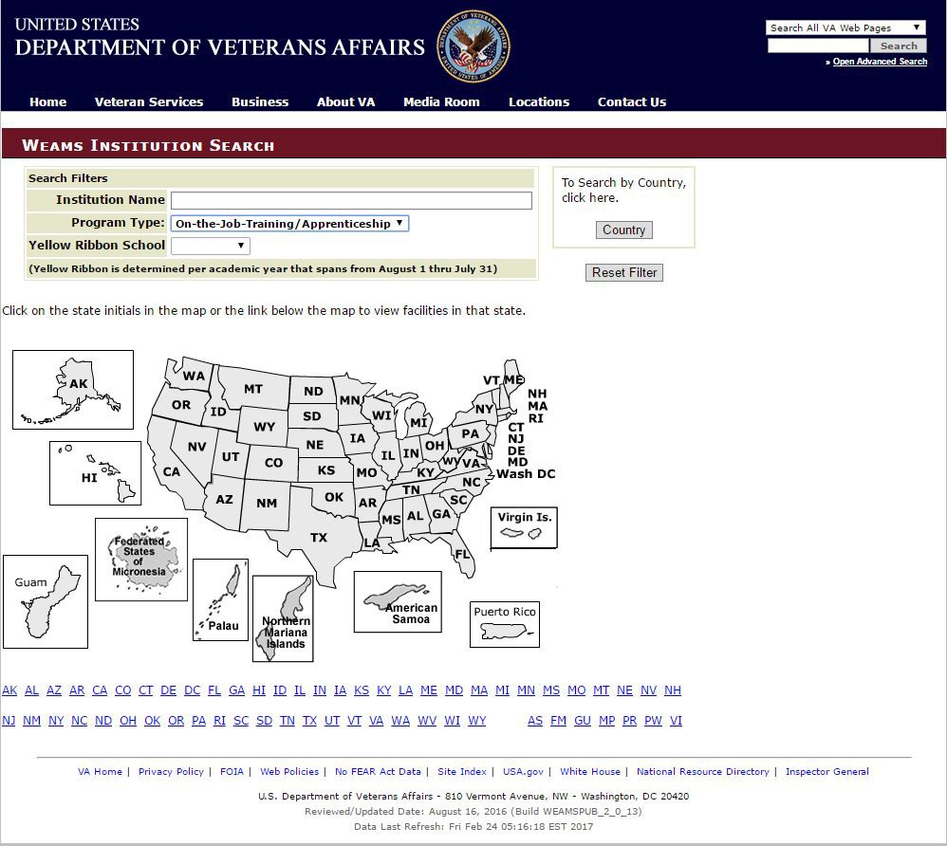
Department of VA Approved Education & Job Training Programs Search
URL:
http://inquiry.vba.va.gov Steps to access Institution Search:
Go to the URL, then type in the following: weamspub/buildSearcvhIn stitutionCritera.do
Program Type:
  Institute of higher learning
    Non College Degree
    OJT/Apprenticeship
    Correspondence
    Flight
    All Types
Search by filters or by state

Slide 13
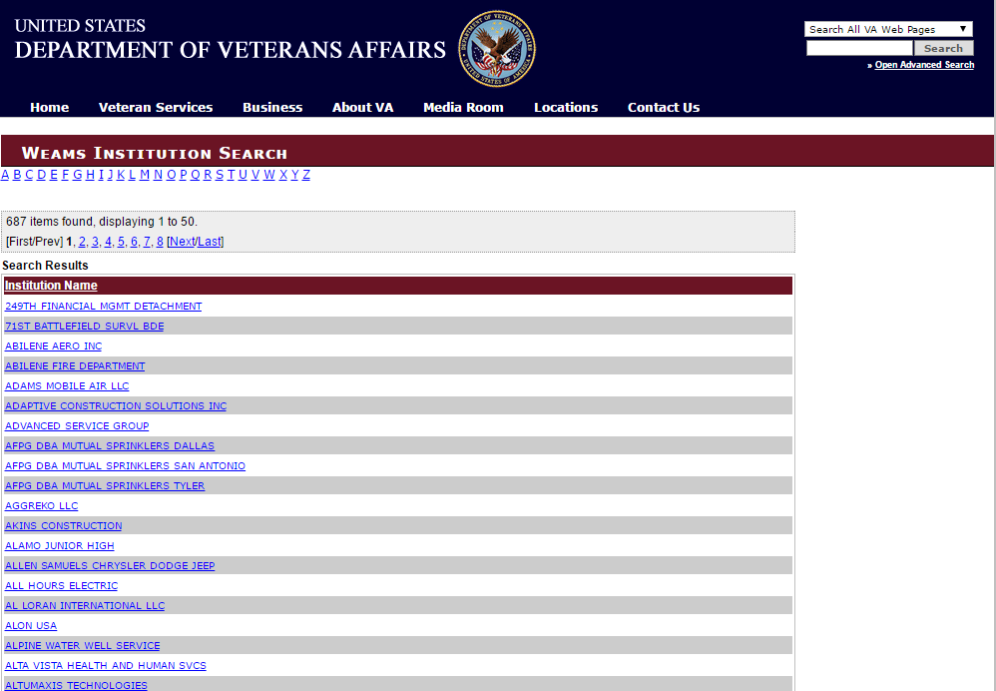
Weams Institution Search
Program Type: OJT/Apprenticeship State: Texas
Click
Ex: Adams Mobile Air LLC

Slide 14
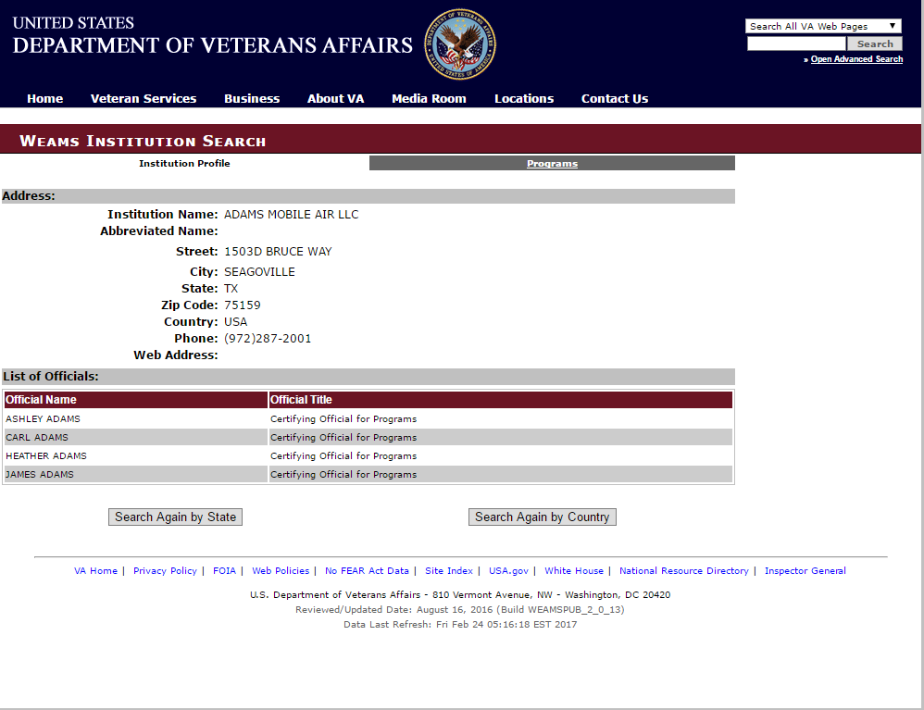
Weams Institution Search: Adams
Mobile Air LLC

Slide 15


Slide 16
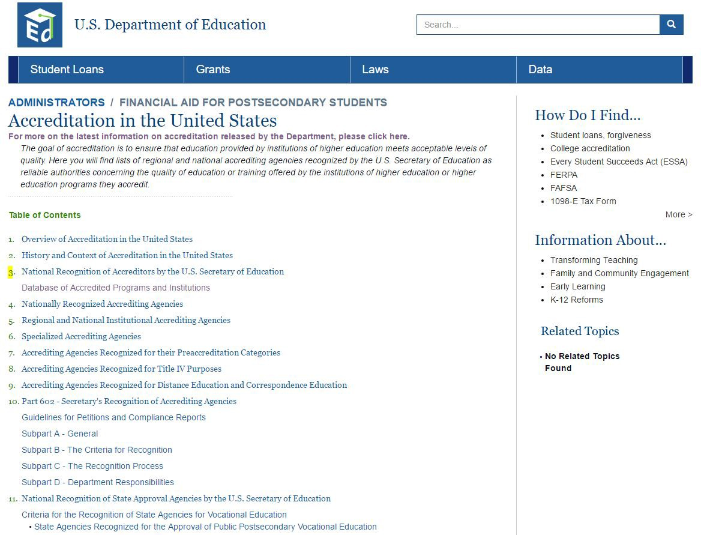
U.S. DOE
Database of Accredited Programs and Institutions
URL:
http://www2.ed.gov/admins/finaid/accred
/index.html
Steps to access Institution Search:
Select link: Database of Accredited Programs and Institutions.
Click

Slide 17
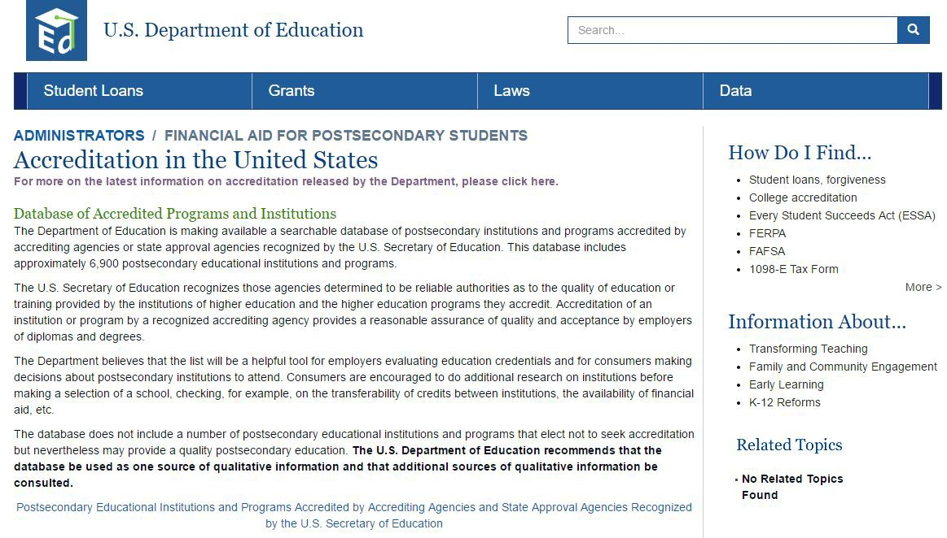
U.S. DOE Database of Accredited Programs and Institutions
Accreditation in the United States
Click on link: “For more on the latest information on accreditation released by the Department”

Slide 18
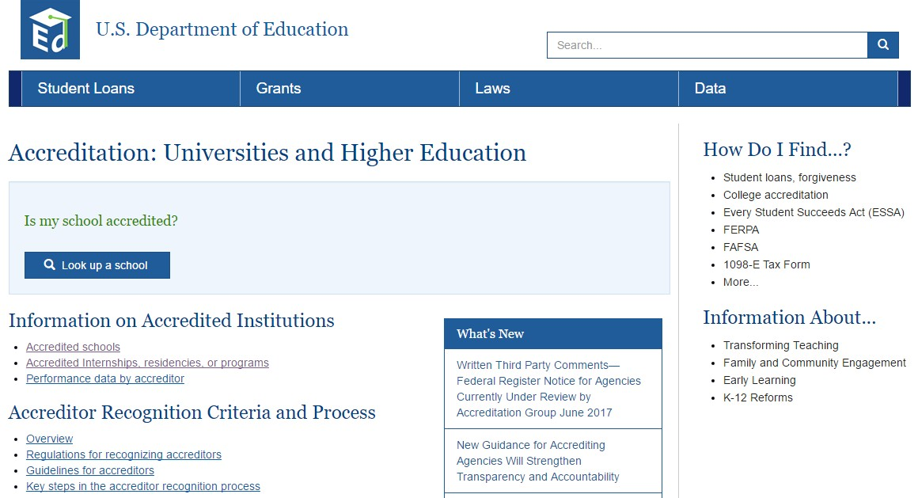
U.S. DOE
Database of Accredited Programs and Institutions Information on Accredited Institutions
Click on link: “Accredited Internships, residencies, or programs”
Click

Slide 19
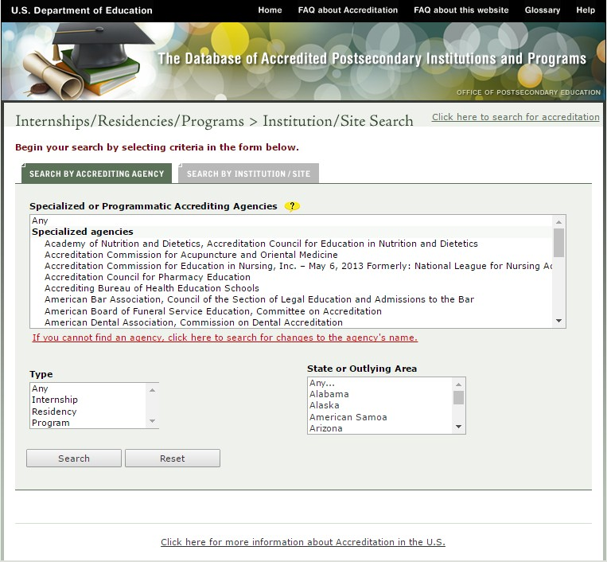
U.S. DOE
Database of Accredited Programs and Institutions Information on Accredited Institutions
Use search filters shown or
Click on tab: Search By Institution/Site
Click

Slide 20
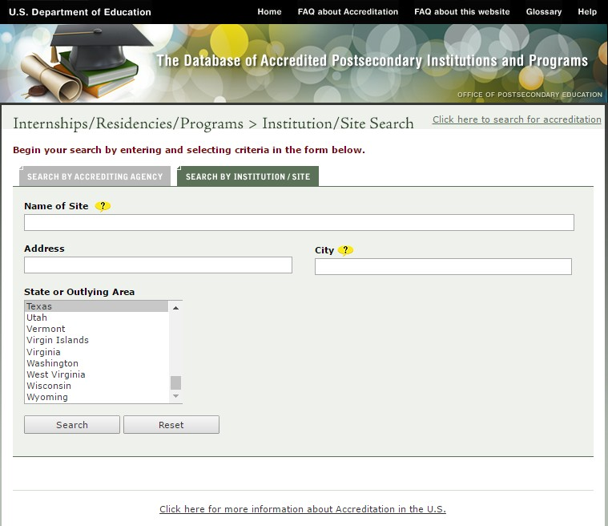
U.S. DOE
Database of Accredited Programs and Institutions Internships/Residencies/Programs > Site Search Search By Institution/Site Tab
Use search filters shown to begin search
Ex: Texas

Slide 21
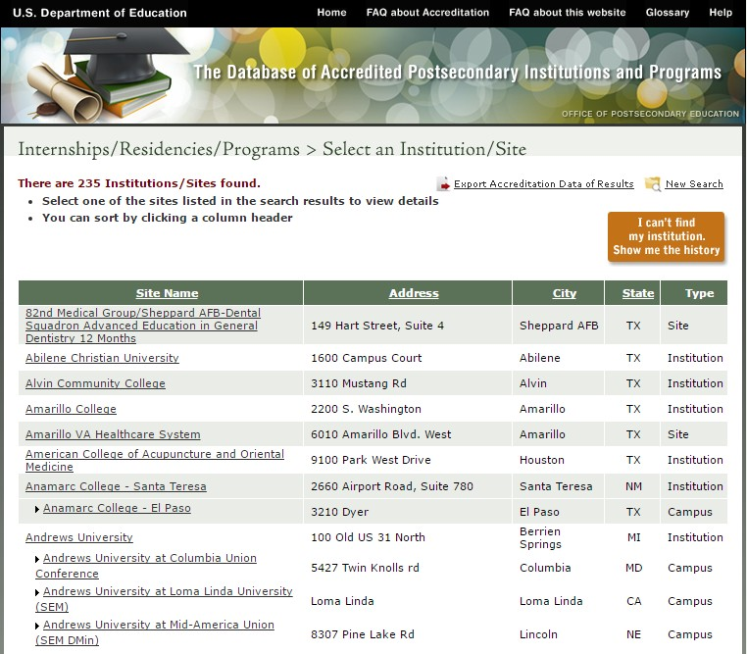
U.S. DOE
Database of Accredited Programs and Institutions Internships/Residencies/Programs > Select an Institution/Site Search By State
Search result by state of Texas:
235 Institutions/Sites found
Export Accreditation Data of Results
Example Scroll Down to: Austin Language Learning School

Slide 22
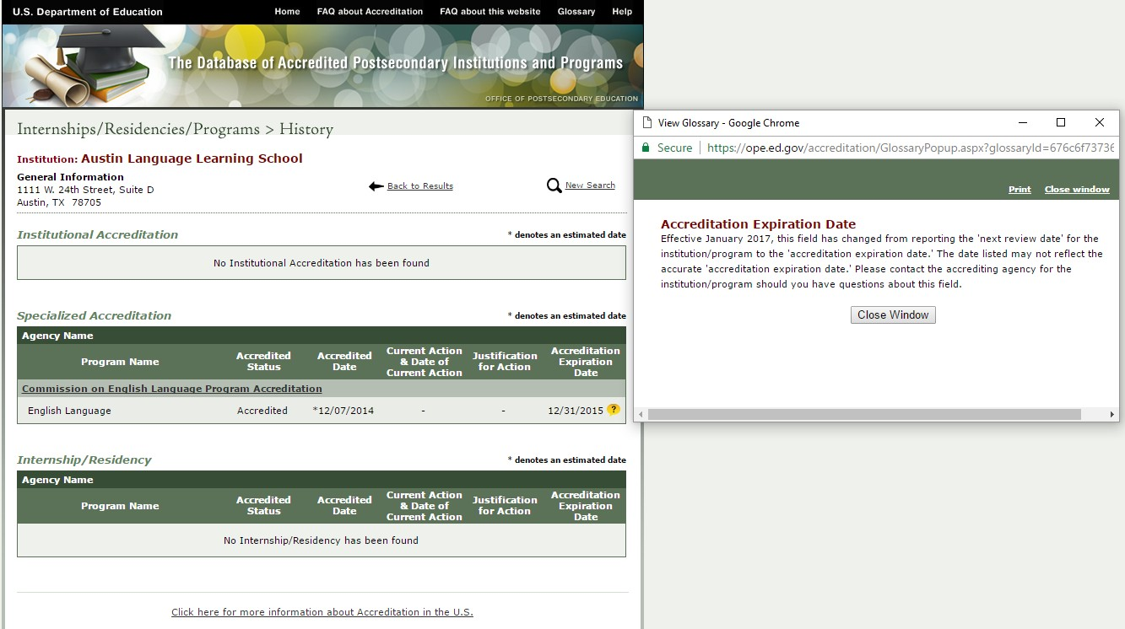
U.S. DOE
Database of Accredited Programs and Institutions Internships/Residencies/Programs > Select an Institution/Site Search By Institution
Click

Slide 23
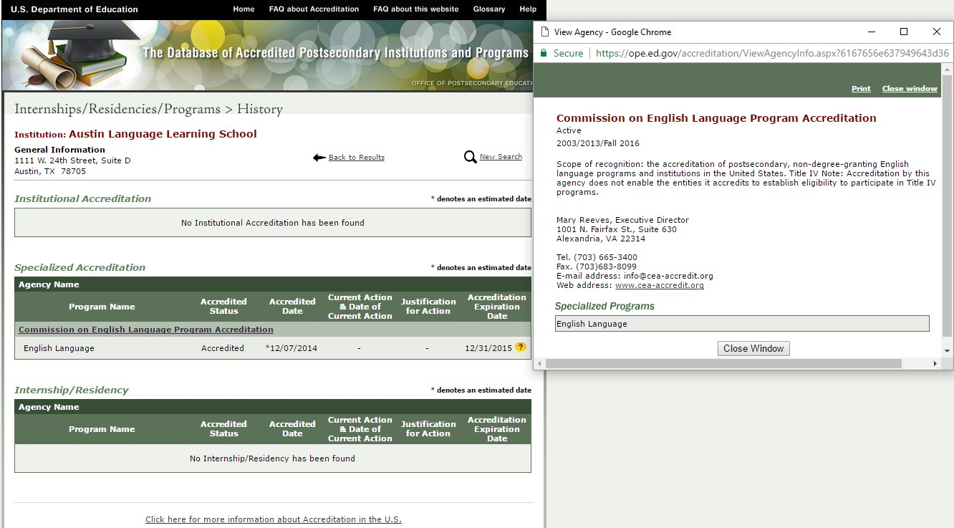
U.S. DOE
Database of Accredited Programs and Institutions Internships/Residencies/Programs > Select an Institution/Site Search Result by Selected Institution
Click
Commission of English Language Program Accreditation

Slide 24

U.S. DOE
Database of Accredited Programs and Institutions Information on Accredited Institutions
Click

Slide 25

U.S. DOE
Database of Accredited Programs and Institutions FAQs About This Web Site

Slide 26


Slide 27
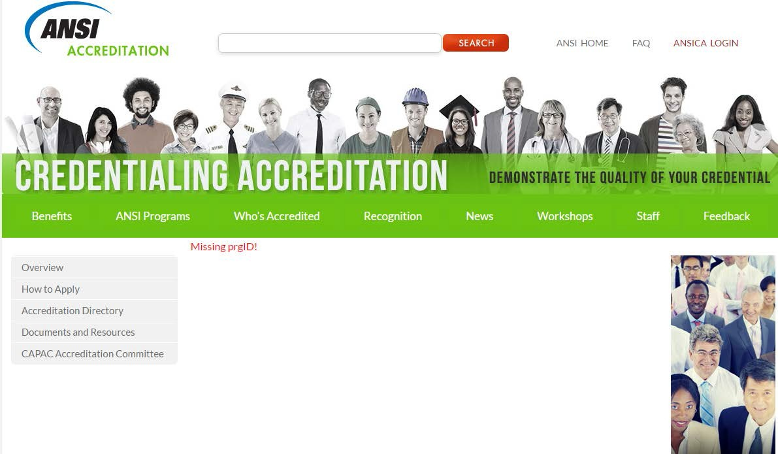
American National Standards Institution (ANSI)
Go to URL: https://www.ansi.org/ Accreditation/credent ialing/certificate- issuers/AllDirectoryLis ting
Click Accreditation Directory to get to:
“Directory of Accredited Certificate Issuers, Applicants and Suspended Issuers”
Click

Slide 28
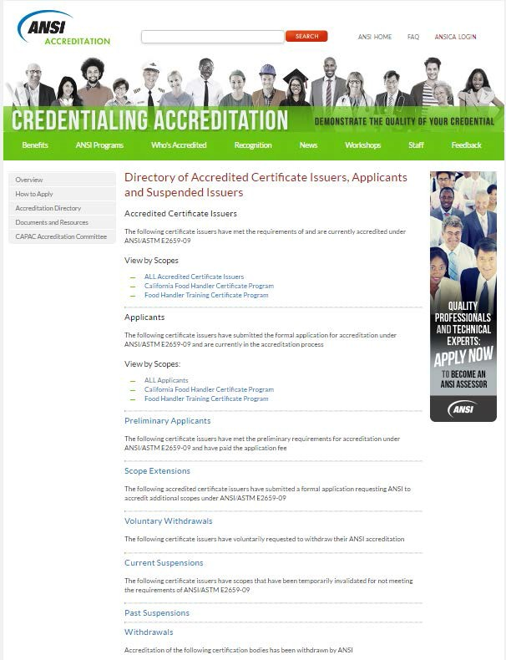
ANSI Directory of Accredited Certificate Issuers, Applicants and Suspended Issuers
Click
ALL Accredited Certificate Issuers

Slide 29
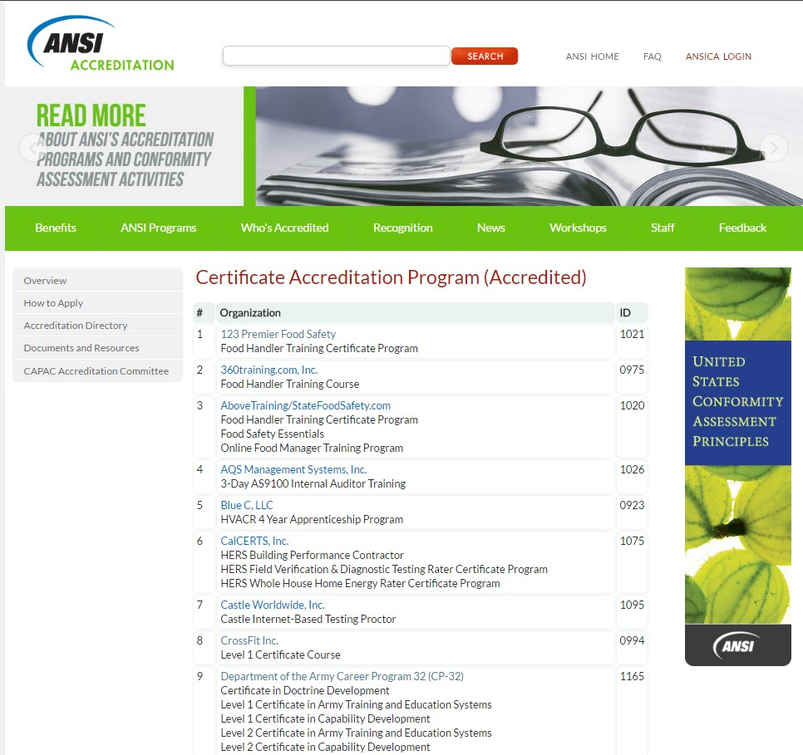
ANCI Certificate Accreditation Programs (Accredited)
Ex: Click on CrossFit Inc.
Click

Slide 30
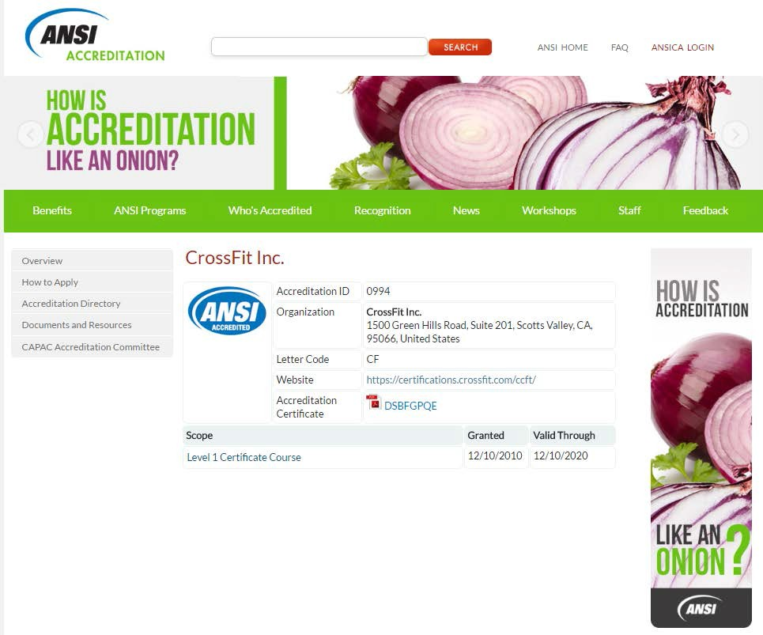
ANCI Certificate Accreditation Program (Accredited)
CrossFit Inc.
Click on Website link:
https://certifications.cr ossfit.com/ccft/
to view eligibility requirements
Click

Slide 31



Slide 32
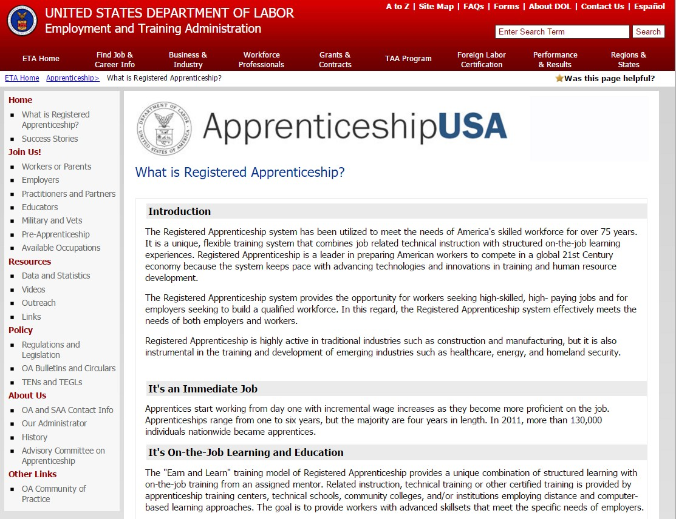
Department of Labor Office of Apprenticeship (DOL/OA)
URL:
http:’’www.doleta.gov OA/apprenticeship.cfm
Introduction
It’s an Immediate Job
OJT Learning and Education
It’s a Credential
Advantages of Registered Apprenticeship
Role of the Government
Program’s
Requirements

Slide 33
Department of Labor Office of Apprenticeship (DOL/OA)
Click
Military and Vets

Slide 34
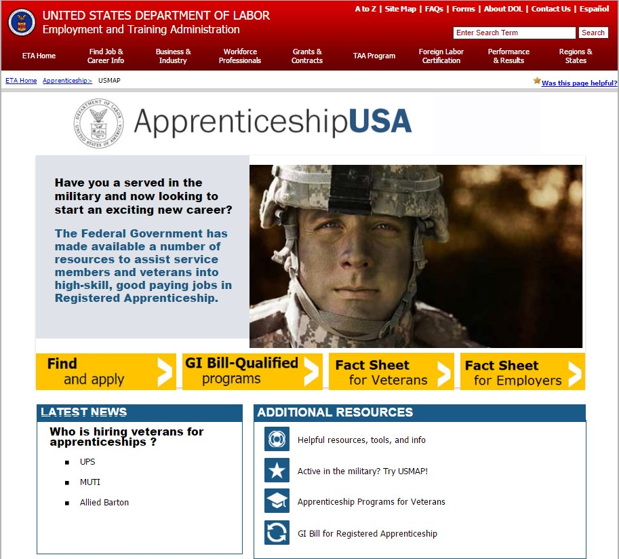
Department of Labor Office of Apprenticeship (DOL/OA)

Slide 35

Council on Occupational Education
COUNCIL ON OCCUPATIONAL EDUCATION

Slide 36

Council on Occupational Education (COE)
Click
URL:
http://www.council.org/
Steps to access Institution Search:
Go to the URL, then type in the following: accredited-institutions
Select Membership, then select either:
Accredited Institutions (Membership Directory)
Candidate Institutions
Then, download the PDF documents
* The directories are updated 4 times per year after council meetings.

Slide 37
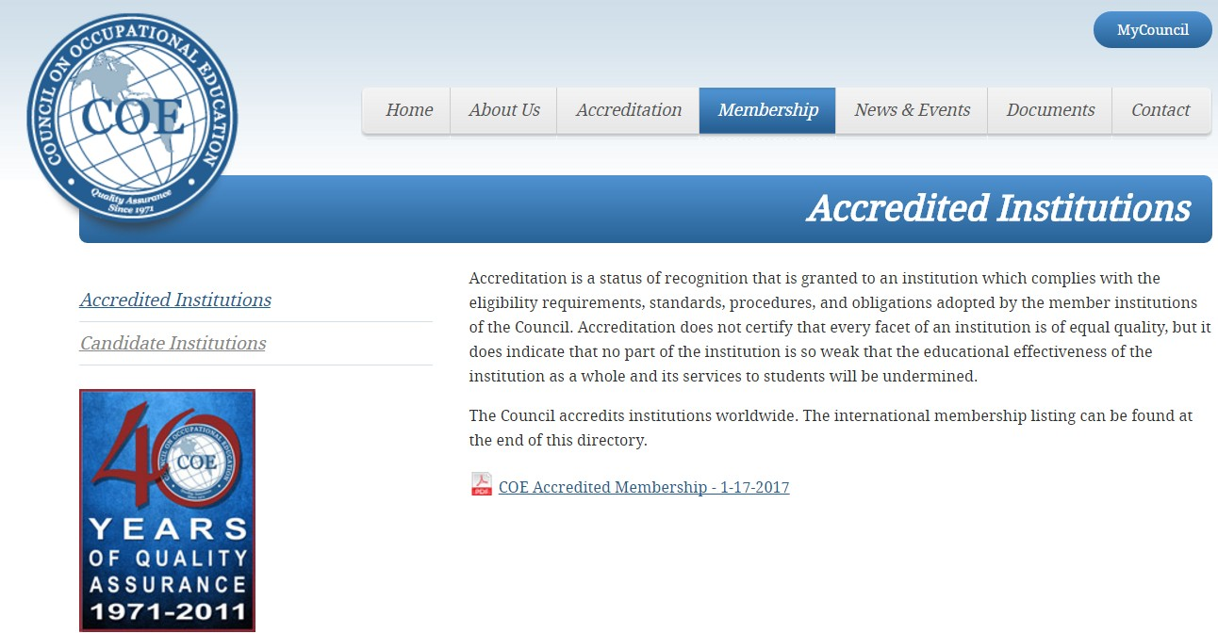


Council on Occupational Education (COE) Accredited Institutions
Membership Directory Accredited Institutions January 2017
COE Accredited Membership

Slide 38
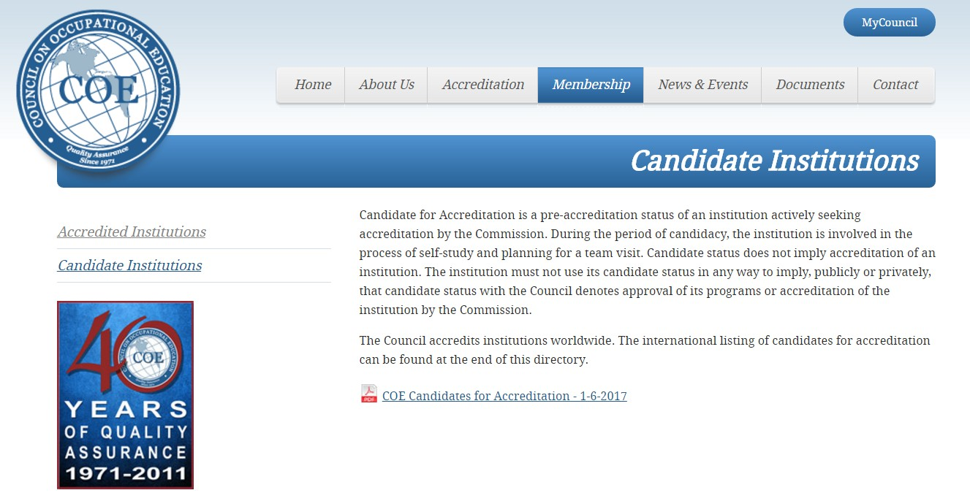
Council on Occupational Education (COE) Candidate Institutions
COE Candidates for Accreditation

Slide 39
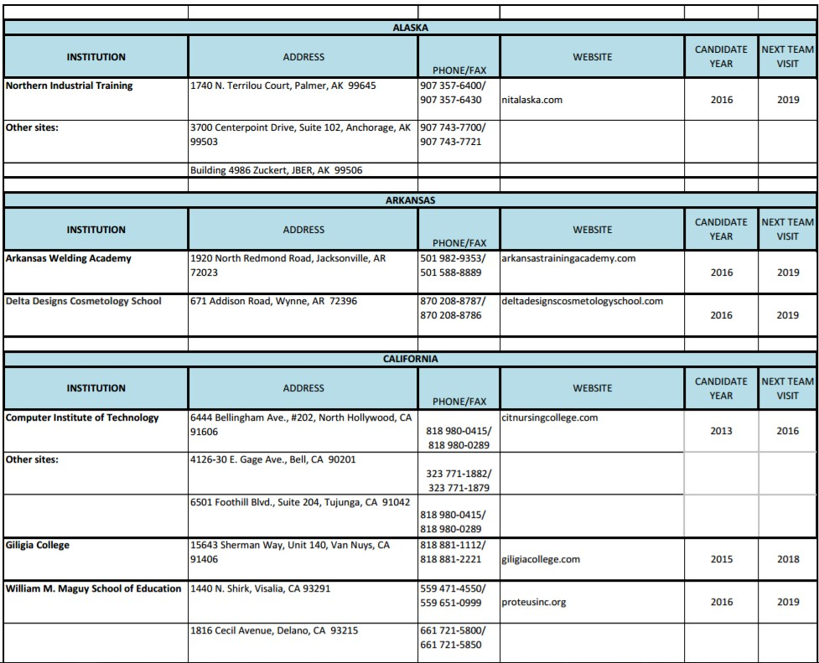
Council on Occupational Education (COE) Candidate Institutions

Slide 40

Federal Law Enforcement Training
Accreditation

Slide 41
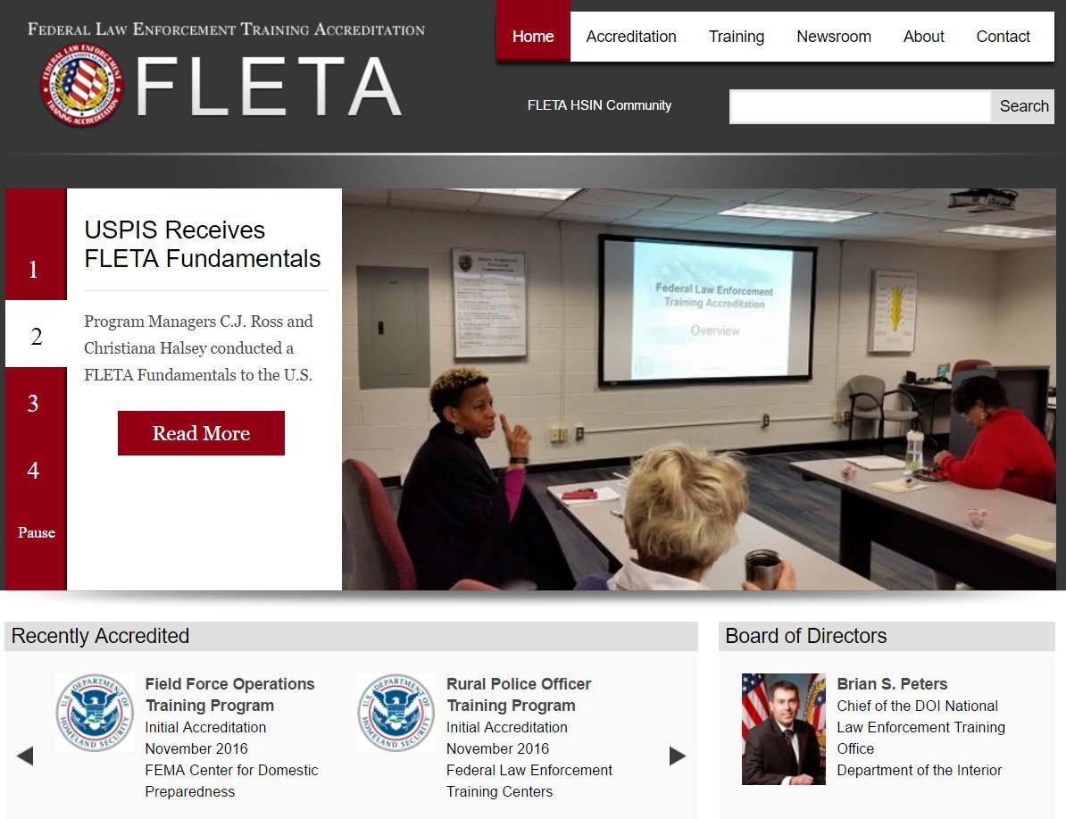
Federal Law Enforcement Training
Accreditation (FLETA)
Click
FLETA
URL:
https://www.fleta.gov/
To begin Search:
- Select Accreditation

Slide 42
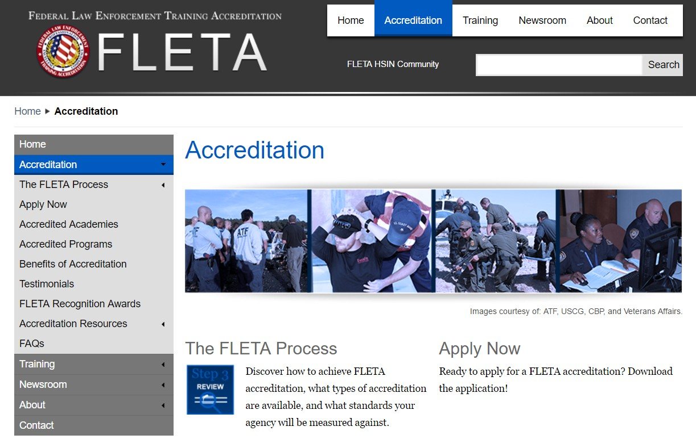

Federal Law Enforcement Training Accreditation (FLETA)
To begin Search:
Select Accredited Academies;
or
Select Accredited Programs

Slide 43
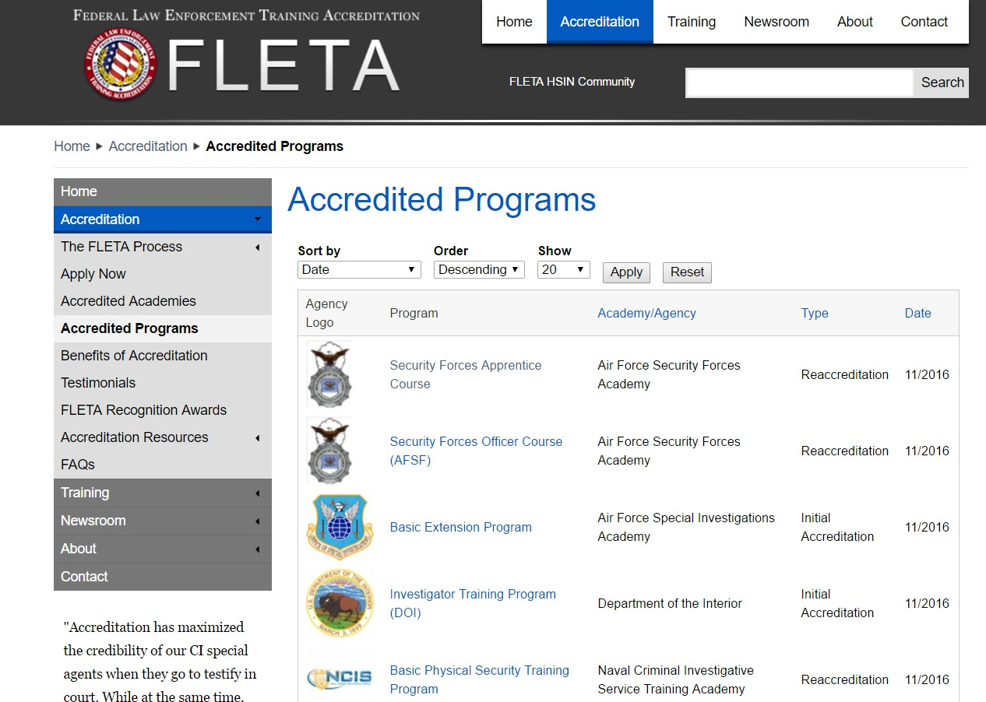
Federal Law Enforcement Training Accreditation (FLETA) Accredited Programs
Click

Slide 44
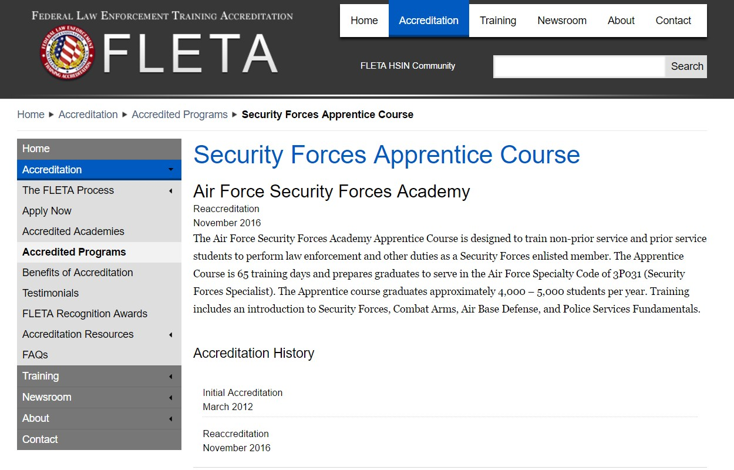
Federal Law Enforcement Training Accreditation (FLETA) Accredited Programs

Slide 45
Questions from the MAJCOMS

Slide 46
Q & A
Where do we find the Career Skills Program Exit
Survey?
ANSWER: The exit survey is found in AFAEMS.
How is terminal / permissive leave being handled in conjunction with the CSP?
ANSWER: Permissive TDY can be taken BEFORE or AFTER but not while on CSP (DCS 30 Nov Q&A - AFAEMS Resources)

Slide 47
Q & A
The DoDI 1322.29 criteria for the provider to be registered
under the specified entities (i.e. DoE, DoL, etc.) is not listed, mentioned in our AFI. Most businesses in our small town are not going to be registered under any of those entities. How can our airmen can benefit?
ANSWER: The Services are required to vet companies IAW DoDI 1322.29 criteria. Companies not listed/registered should be referred to the applicable sites or to the SkillBridge site to gain information about applying for membership. In the meantime, refer Airmen to local job fairs, the Chamber of Commerce, or state employment agency.

Slide 48
Q & A
Is there an AFAEMS report that pulls the names of current and
recent CSP participants?
ANSWER: AFAEMS has two reports supporting the Career Skills Program (CSP):
The “Career Skills Program Report” – Provides information on students with approved CSP applications.
The “Career Skills Program Exit Survey Report” –Career Skills Program Exit Survey Metrics.
Although the program is not working for overseas locations I want to know if there is a consolidated listing of locations and program in the states that we can provide to service members prior to departing overseas?
ANSWER: Contact the local Transition Assistance Center for information.

Slide 49
Q & A
We recently received a message regarding the lack of a need
for an MOU between the training partners and the education section. If an MOU is not in place, what will ensure a well organized and coordinated training program for is in place?
ANSWER: The CSP application/memorandum initiated by the Airmen will include relevant information/details about the training program and will be signed by the Airman and the Commander.
How does the Airman receive information about CSP? How do they know it even exists. I already have brochures and flyers in my Education Center for the customers.
ANSWER: There is a MyPers message on the Air Force Personnel Center (AFPC). Various websites discussed in this briefing.

Slide 50
Air Force Personnel Center

Slide 51
BACK UP SLIDES

Slide 52
Air Force Unemployment Compensation Benefits
 | FY |  | 2015 |  | 2016 |  |  | 2017
 | QTR
 | 1st |  | $ 19,789,507.84 |  | $11,136,025.96 |  |  | $8,001,675.83
 | 2nd |  | $ 18,028,694.38 |  | $10,239,373.86
 | 3rd |  | $ 13,917,384.51 |  | $9,102,935.07
 | 4th |  | $ 12,086,418.66 |  | $8,492,750.00
 | Total |  | $ 63,822,005.39 |  | $ | 38,971,084.89 |  | $ | 8,001,675.83
Grand Total
$ 110,794,766.11

Slide 53

CSP Providers
HOLT® CAT is the authorized Caterpillar® heavy equipment and engine dealer for 118 counties in South, Central, North and East Texas. Established in 1933, HOLT sells, services and rents Cat equipment, engines and generators for construction, mining, industrial, petroleum and agricultural applications. HOLT sells Caterpillar used equipment worldwide and fabricates its own line of custom engineered products including root plows and water tankers.
Available Tracks:
Class Breakdown:
-8 to 20 weeks
-Classroom & On-the- job training
-Tool Room Tech (8 Wk)
-Heavy Equip Tech (16 Wk)
-Power Generation (16 Wk)
-Engine Tech (16 Wk)
-Machinist (20 Wk)
-Fabrication (20 Wk)
-Crane Tech (16 Wk)
-Inventory Control (12 Wk)

Slide 54

CSP Providers Internship
Accenture is a leading global professional services company, providing a broad range of services and solutions in strategy, consulting, digital, technology and operations.
Class Breakdown:
2-4 Week “Bootcamp” Residency & Web- based
-0800 to 1700
-Self study/self directed
-Computer Based
-Team setting w/ coach
*Post Bootcamp OJT
Information Technology
Current Programs Available:
-Java (4 Wk)
-Oracle (4 Wk)
-SAP (4 Wk)
-Testing (2 Wk)
--Functional & Technical testing
--Test Planning, Scripting, & Execution
-Infrastructure Services (2 Wk)
--Network & Server Administration
--Intro to Cloud Computing

Slide 55






CSP Providers Employment Skills Training
JBSA O2O Manager: Anthony Cosby
Class Break Down: 4 days in-class
5 weeks online
Customer Service Excellence
Information Technology
CompTIA A+ CompTIA Network+
Cisco Certified Network Technician Cisco Certified Network Associate CompTIA Security+
Systems Security Certified Practitioner Information Systems Security Professional JAVA SE7 Fundamentals
2017 Calendar:
Jan 23-27
Apr 4-7
Jun 6-9
Aug 29 – Sep 1
Oct 17-20
Customer Relations Models Personal Analysis of Customer Service Style
Situation-Specific Customer Service Strategies for Excellence Leading with Excellence
Case Studies
*Completion connects service member to high-demand career with partner companies:

Slide 56

CSP Providers Employment Skills Training
Current Programs Available:
-NABCEP Associate Level
The SunShot Initiative's Solar Ready Vets program connects our nation’s skilled veterans to the solar energy industry, preparing them for careers as solar photovoltaic (PV) system installers, sales representatives, system inspectors, and other solar- related occupations.
Solar Ready Vets is enabled by the U.S. Department of Defense’s SkillBridge initiative, which allows exiting military personnel to pursue civilian job training, employment skills training, apprenticeships, and internships up to six months prior to their separation.
Program Design:
Learning Goals aligned around the NABCEP ELE
  (North American Board of Certified Energy Practitioners
– Entry Level Exam)
Hands-on experience w/ solar system site analysis, design, installation, commissioning, operation, & maintenance
Safety issues unique to solar plus OSHA 10 or 30
Transition planning and individual
support of entry into the solar industry

Slide 57



CSP Providers Employment Skills Training
The Alamo Area Regional Law Enforcement Academy Basic Peace Officer Program
Basic Correction Officer programs Basic Telecommunications Certification
Licensure via Texas Commission on Law Enforcement.
Microsoft Software & Systems Academy
Helps active duty U.S. service members develop the career skills necessary to meet the IT industry’s high demand for cloud developers, cloud administrators, and database and business intelligence administrators.
WellMed Internship Program
Delivers quality health care to people eligible for Medicare through the WellMed Care Model. They specialize in helping patients stay healthy by providing the care they need from doctors who care about them.

